Slide 1
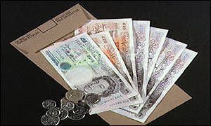
How much is the Minimum wage ?

Slide 2
The Minimum wage is £6.50 per hour

Slide 3
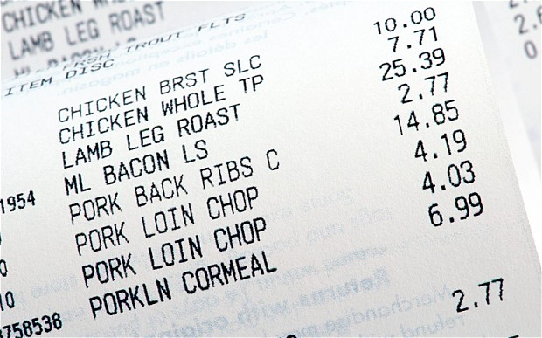
How much is the Average food bill per year ?

Slide 4
The Average food bill is £5000 per year

Slide 5

How much does the Average holiday for a family of 4 cost?

Slide 6
The Average holiday for a family of 4 cost £4,792

Slide 7

How much does the Average car cost to run each year ?

Slide 8
The Average car cost £2000 per year to run

Slide 9

Budget time
Average Joe
Joe earns £10,000 per year.
Joe
Eats the average amount of food
Goes on the average family of 4 holiday each year
Runs a average car
Using the information previously given work out, How much money will Joe have left ?

Slide 10
Joe has -£1792 left!!!

Slide 11
Your task
You have 2 minute to name as many things as possible that Joe could do to get out of debt:

Slide 12

What is a loan ?

Slide 13
A loan is a thing that is borrowed, especially a sum of money that is expected to be paid back with interest.

Slide 14

What is APR?

Slide 15
APR means Annual Percentage Rate. This is the amount of how interest added to a loan or credit card each year.

Slide 16
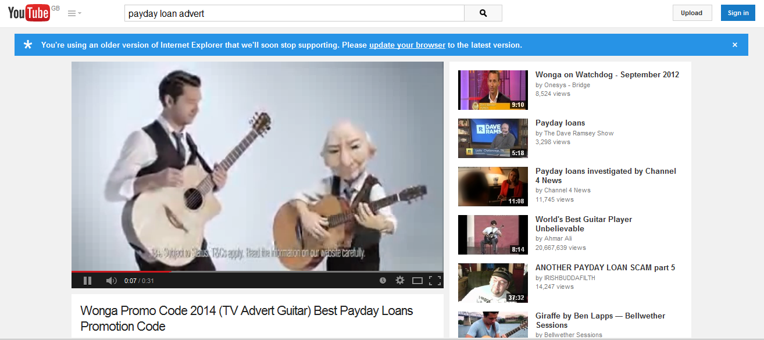
Watch this advert
What do we call these companies?

Slide 17
Watch this advert
https://www.youtube.com/watch?v=lMEgxtQ-4Ew

Slide 18
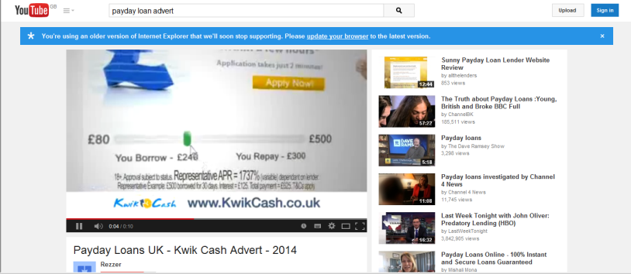
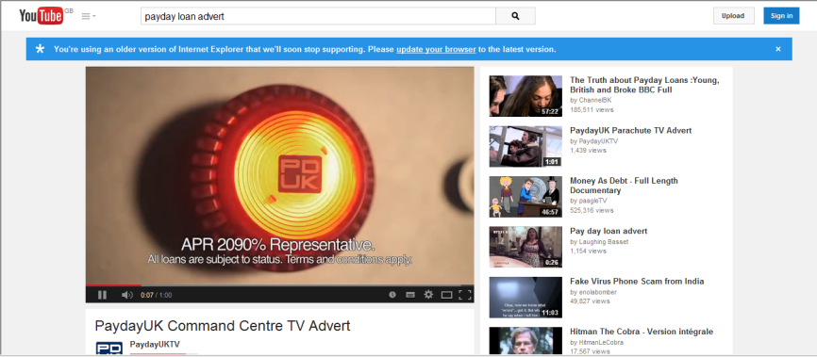
These companies are know as “Payday lenders”
Watch these clips and Look out for the APR!!!!!!

Slide 19


https://www.youtube.com/watch?v=XwKMSPgUhik

Slide 20


https://www.youtube.com/watch?v=VBG1l9oNia8

Slide 21

Discussion Topic
“Are pay day lenders a good thing?”

Slide 22
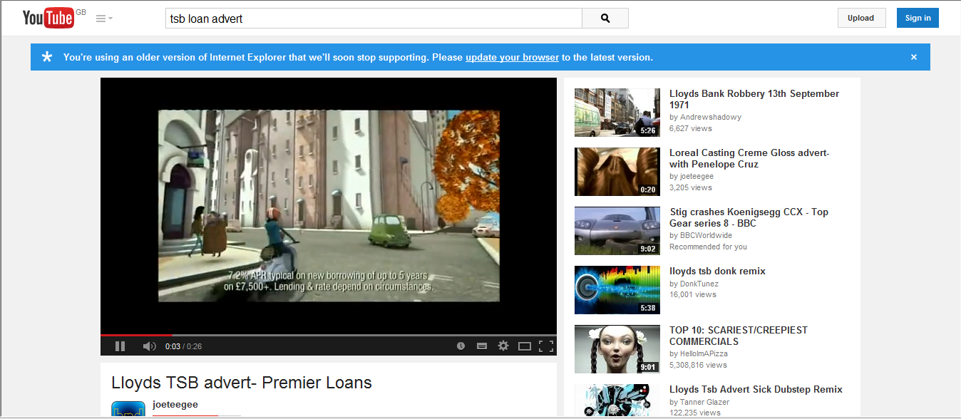
Watch this clip – what do you notice about the APR?
https://www.youtube.com/watch?v=CrbYy1KA0RQ

Slide 23
Your task
You have 2 minute to name the things you are judged upon for a loan:

Slide 24
Your task
The things you are judged upon for a loan:
Your past history
Your earnings
your outgoings
Your Job

Slide 25
Discussion Topic
“is it easy to get a loan?”

Slide 26
Your task
To design 2 posters
Poster 1
Design a poster for a pay day lender with high borrowing and high APR
Describe the advantages of your loan in big text.
Describe the disadvantages of your loan in small text.
Poster 2
Design a credit card with low borrowing and low APR
Describe the advantages and disadvantages of your loan
?

Slide 27
Discussion Topic
“Why do people use pay day lenders?”

